Slide 1
OBJECTIVES
Things I want to decide on- get input as far as where to go / figure edits
How do diffusive hillslopes form here in this bedrock landscapes?
They need an absence of thick beds, so that rock is more erodible and can erode away easy
Some base level fall so that channels and topography form
A big bed, or series of thick beds that can attenuate the signal from baselevel fall so it doesn’t erode away the relict erodible part of the landscape
Beds above the competent lower elevation bed can contribute to preventing the signal from reaching farther upslope
There is some lag distance between a large bed and where diffusive HS form starts
“purgatory” zone between diffusive and linear HS
The distance seems dependant on size of bed
Strength of baselevel fall signal
Lower elevation = stronger signal
Above a large bed or series of beds as kinda “knickpoint” forms (ala perne or forte paper)
Seems like larger bed = more apparent inflection pt

Slide 2
How I will show all this
Map of curvature to show that there are diffusive HS
HS transects to show
Diffusive HS and sections of HS exist
Where there are beds in relation to adjusting and relict hs sections
Big beds change morphology, above big beds where there are no mapped beds, HS appears diffusive
Big beds define inflection pts between non linear and linear sections
Plot slope with a moving average to find locations where HS is diffusive
Use slope plots (where they are “constant” and decreasing, HS is diffusive)
Compare LC1 and LC3
Time is space – higher elevation transects in LC3 are diffuse
LC1- inflection pts in all transects are defined by presence of same bed
MODELING STUFF- what is the way forward??

Slide 3
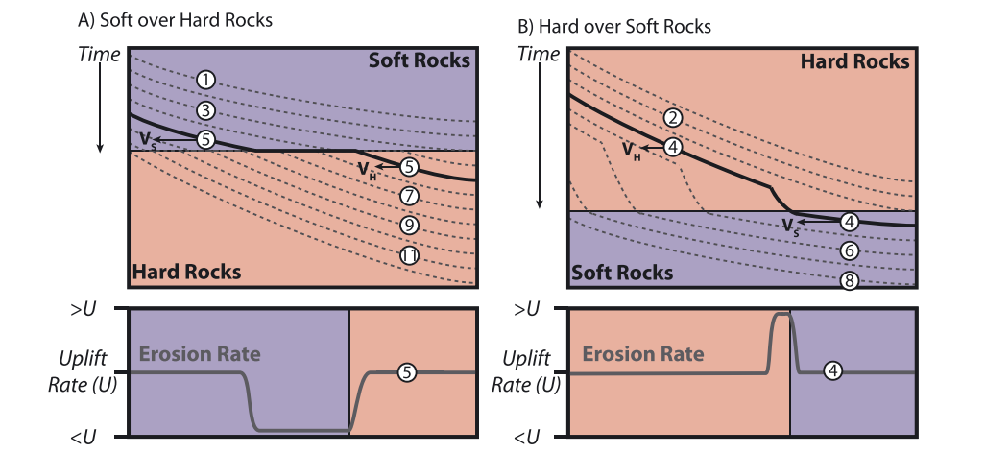

Slide 4
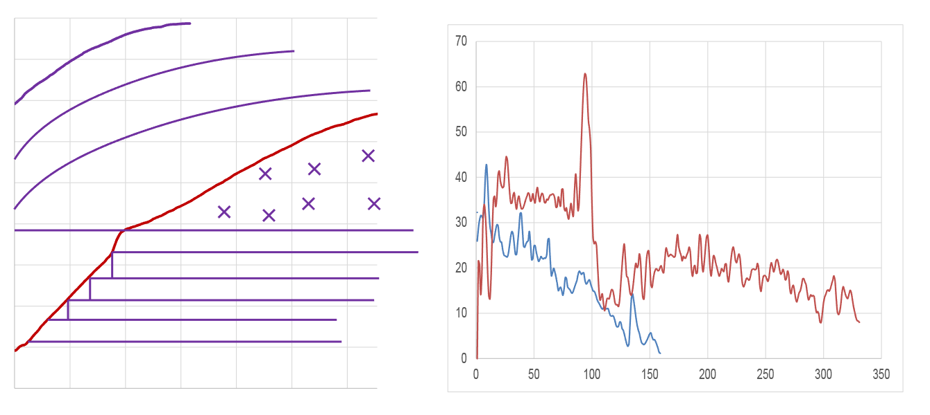

Slide 5
T1
T1
Thin Beds
T1
T1
Thick Bed(s)
Elevation
Thin Beds
Thick Bed(s)
Linear Nonlinear
Linear Nonlinear
Linearity
Purgatory
Nonlinearity
Slope
Linearity
Distance
Distance

Slide 6
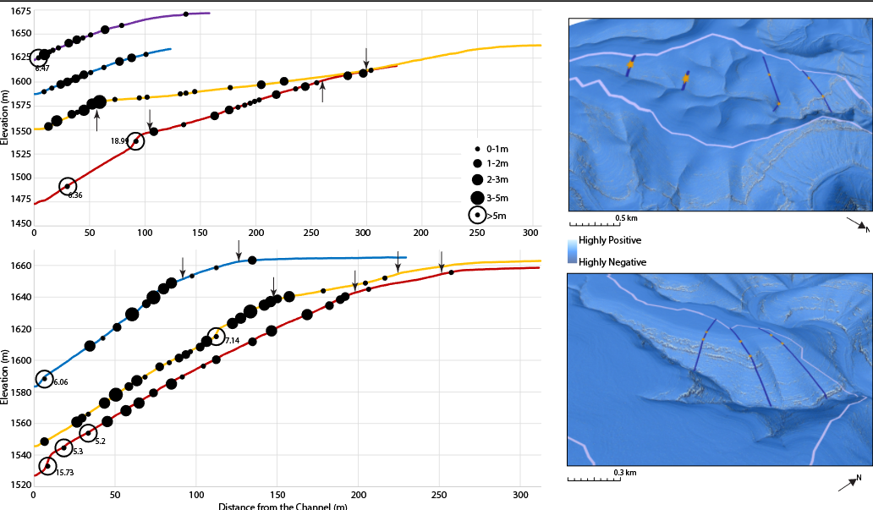

Slide 9
Instead of the maps I’ll put slope plots, scatter or line or line (moving avg)? Beds or no beds?

Slide 10
Figure list
Plan view map with slope distributions and bed thicknesses
Bed distributions, with slope (moving avg), beds?, plus plots of diffusion
Schematic with slope
3d figs, with curvature, angle of inflection, and bed thicknesses effect on distance to diffusion
Modeling results
PS if the second part of fig 4 is too weird, ill present 2 “panels” of modeling results (maybe the end members Joel suggested)

Slide 12
Do I double down on this weird inflection point stuff and put these plots? Especially the thickness of bed vs elevation distance?

Slide 13
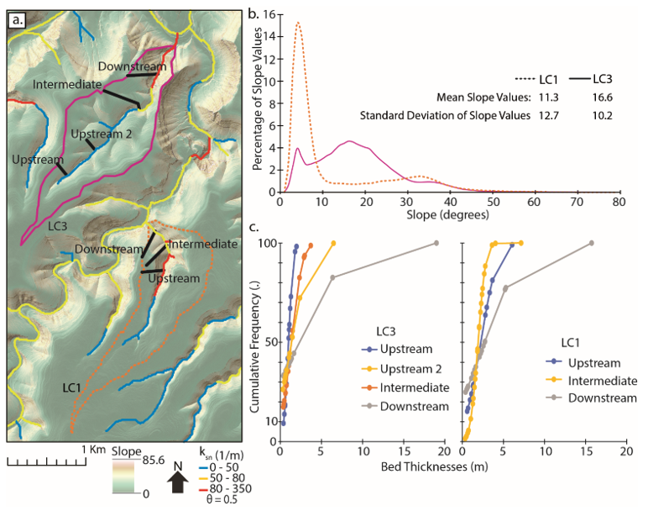

Slide 14
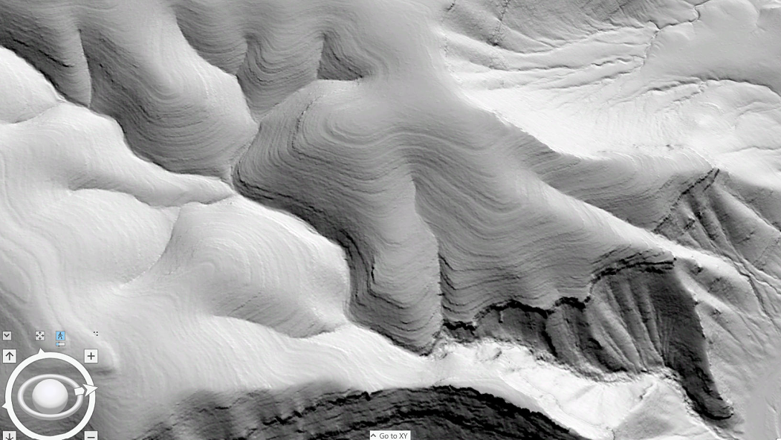
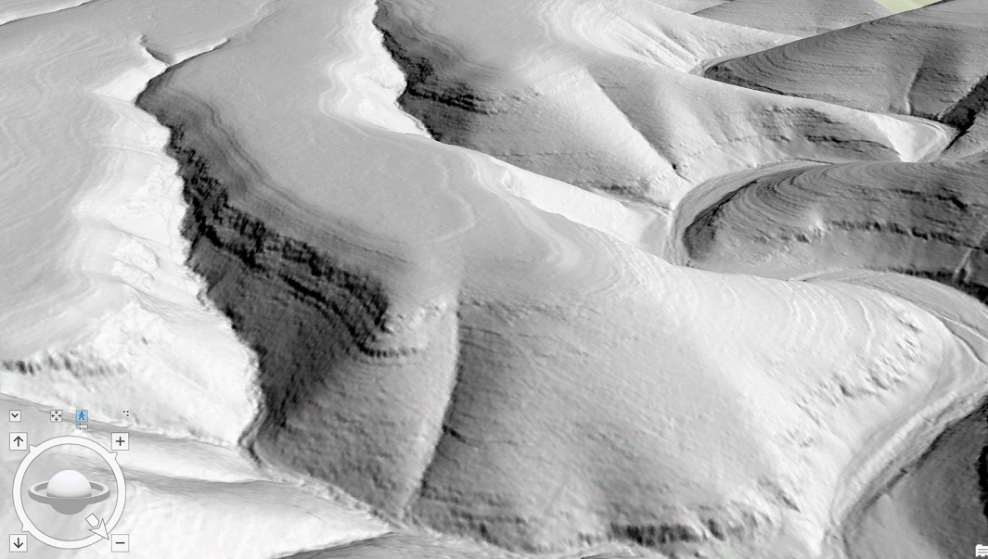


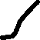

Slide 18
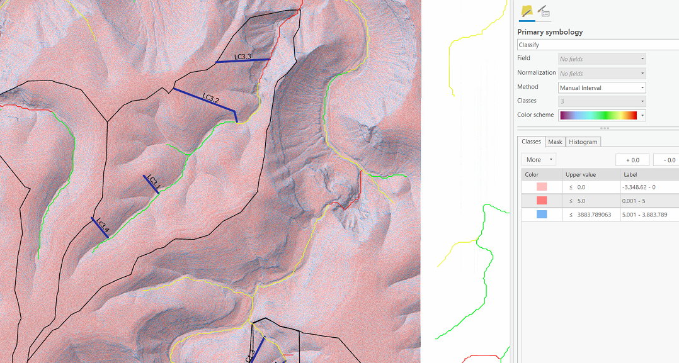
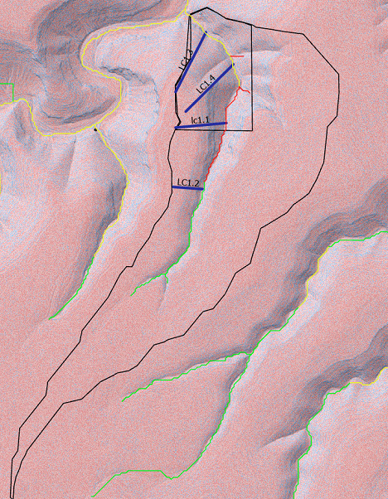

Slide 19
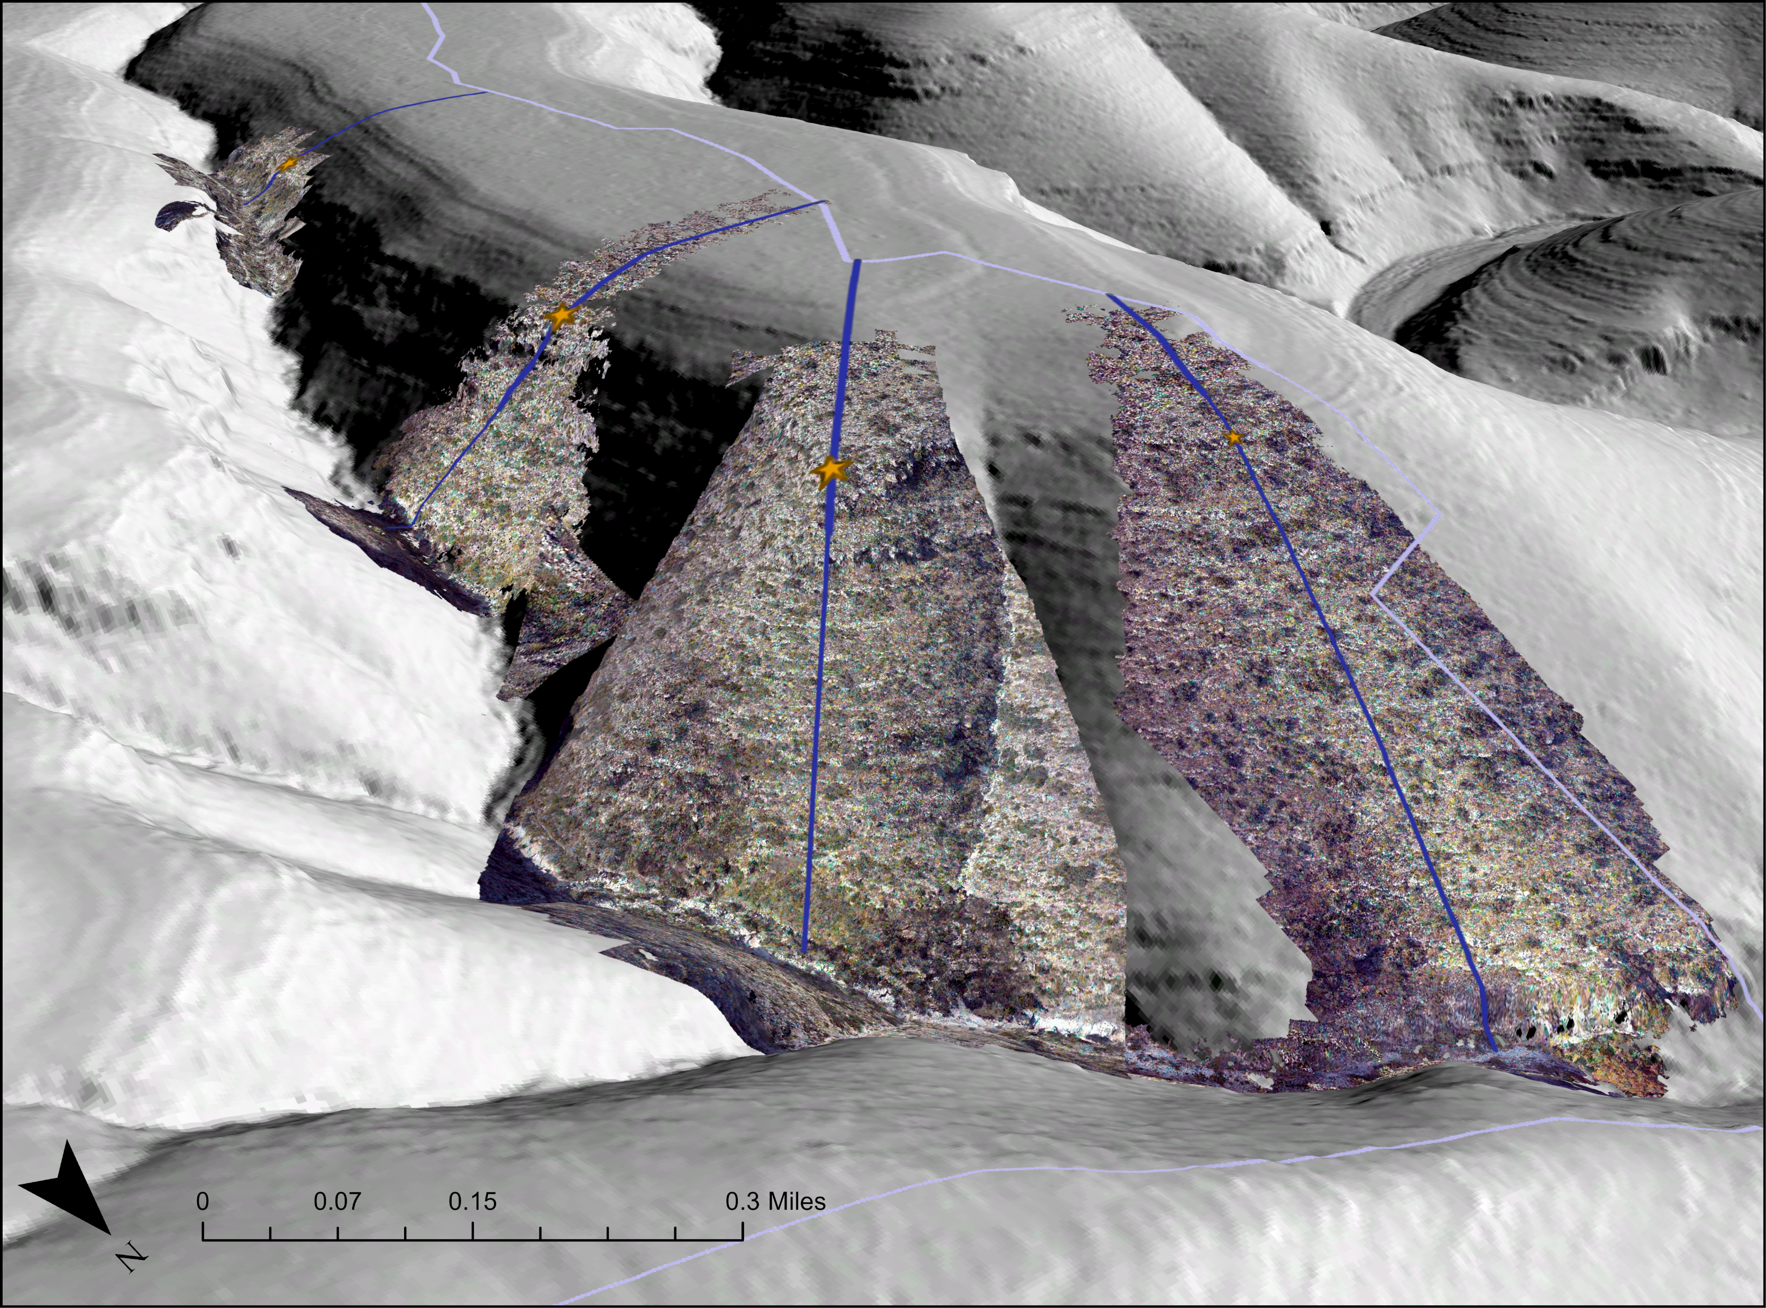
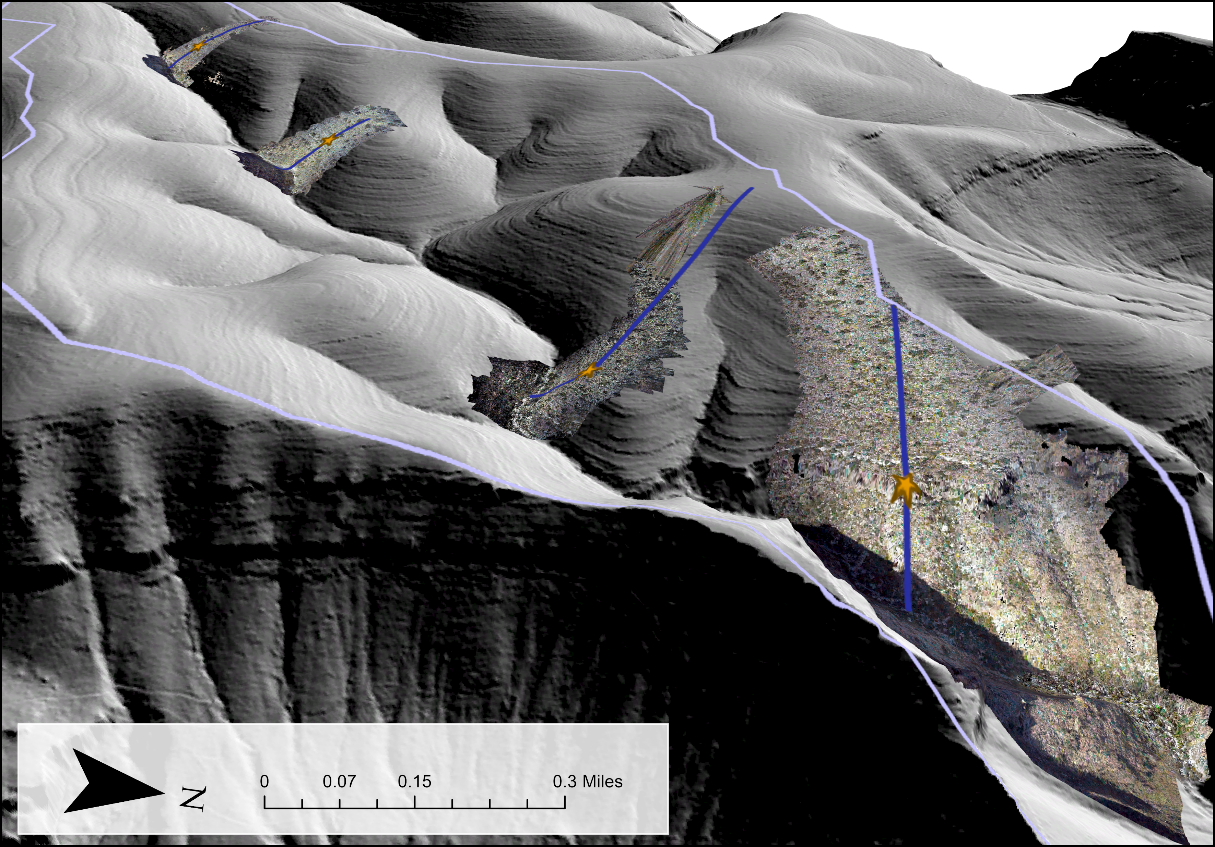

Slide 21
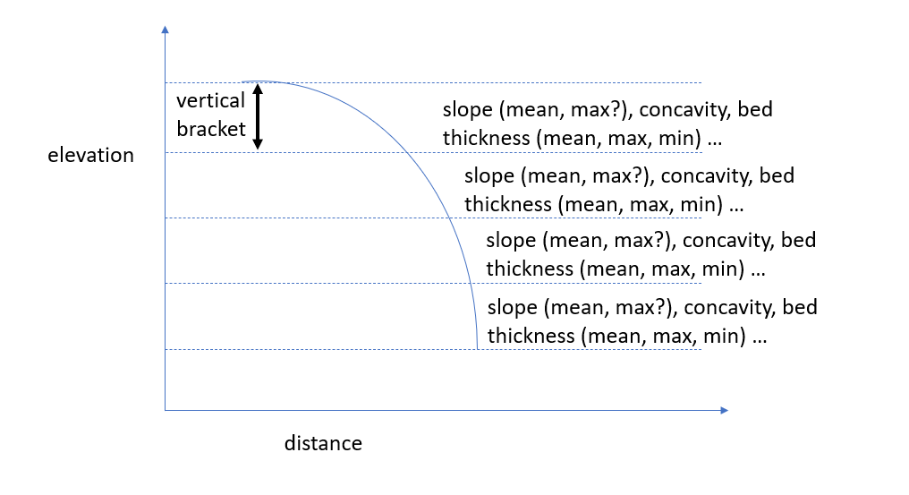

Slide 22
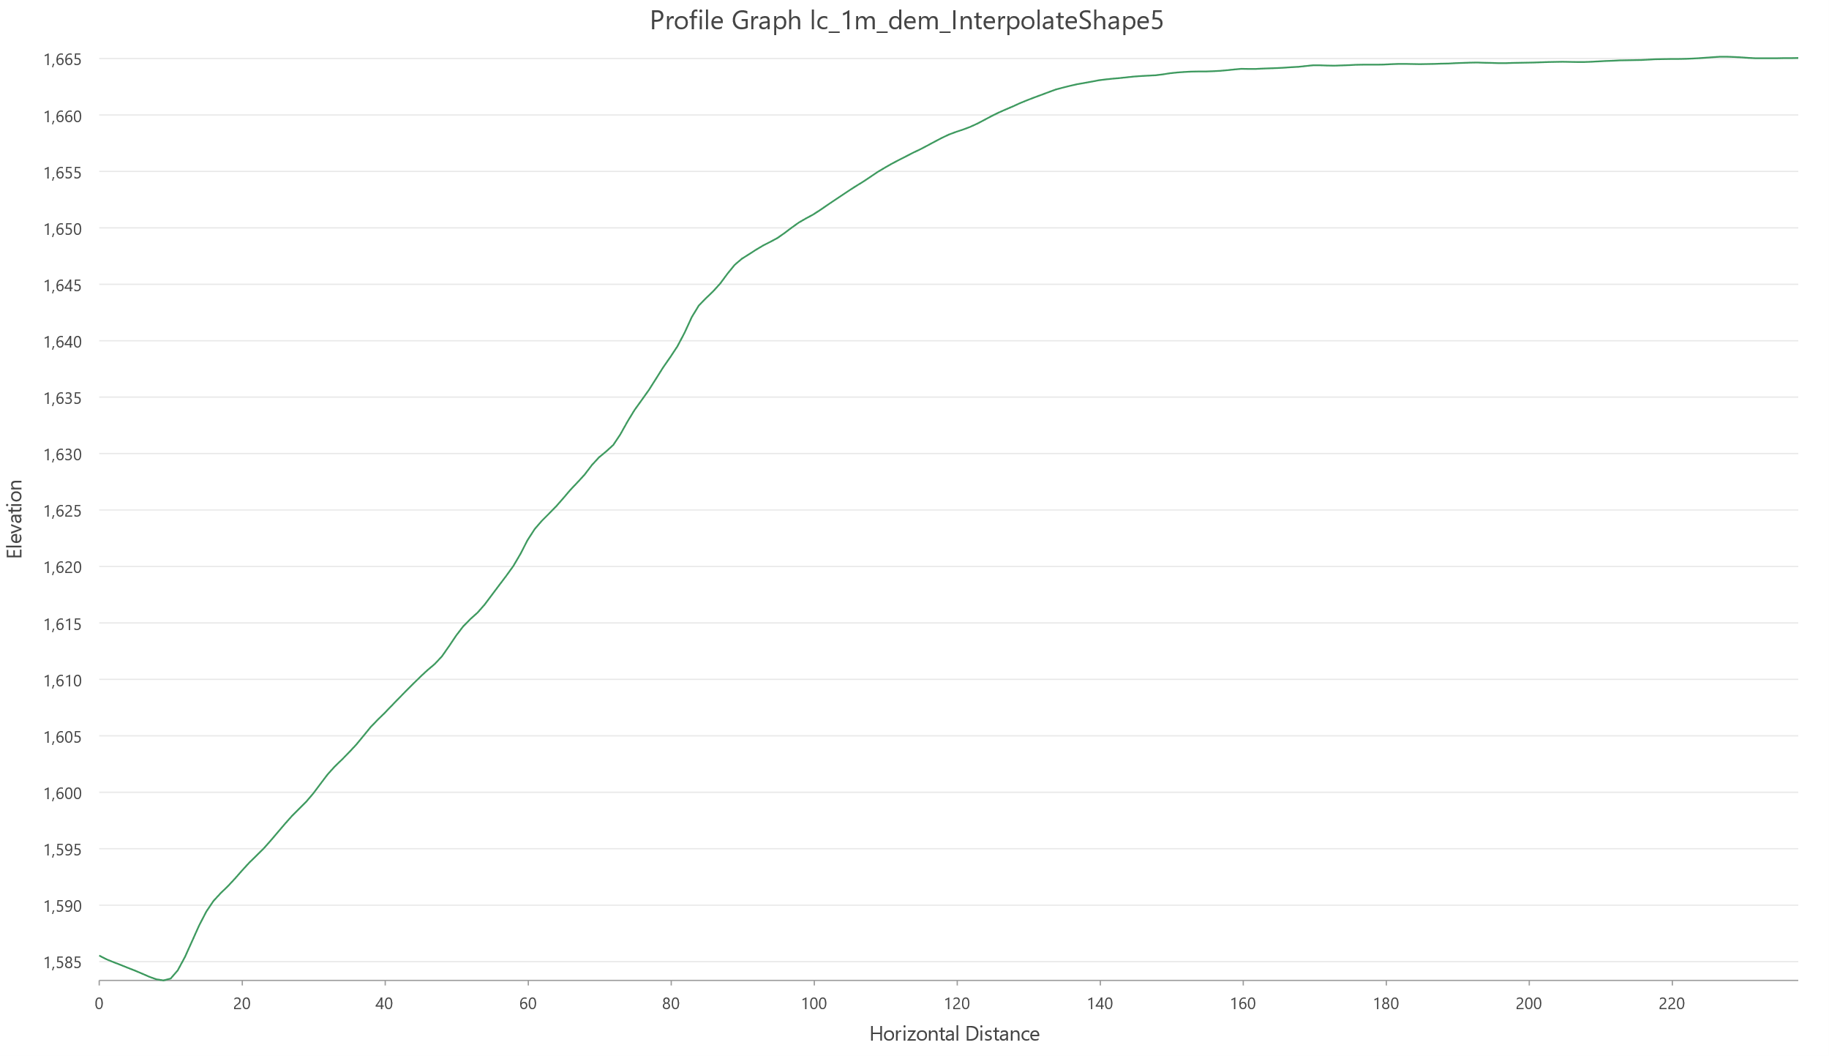
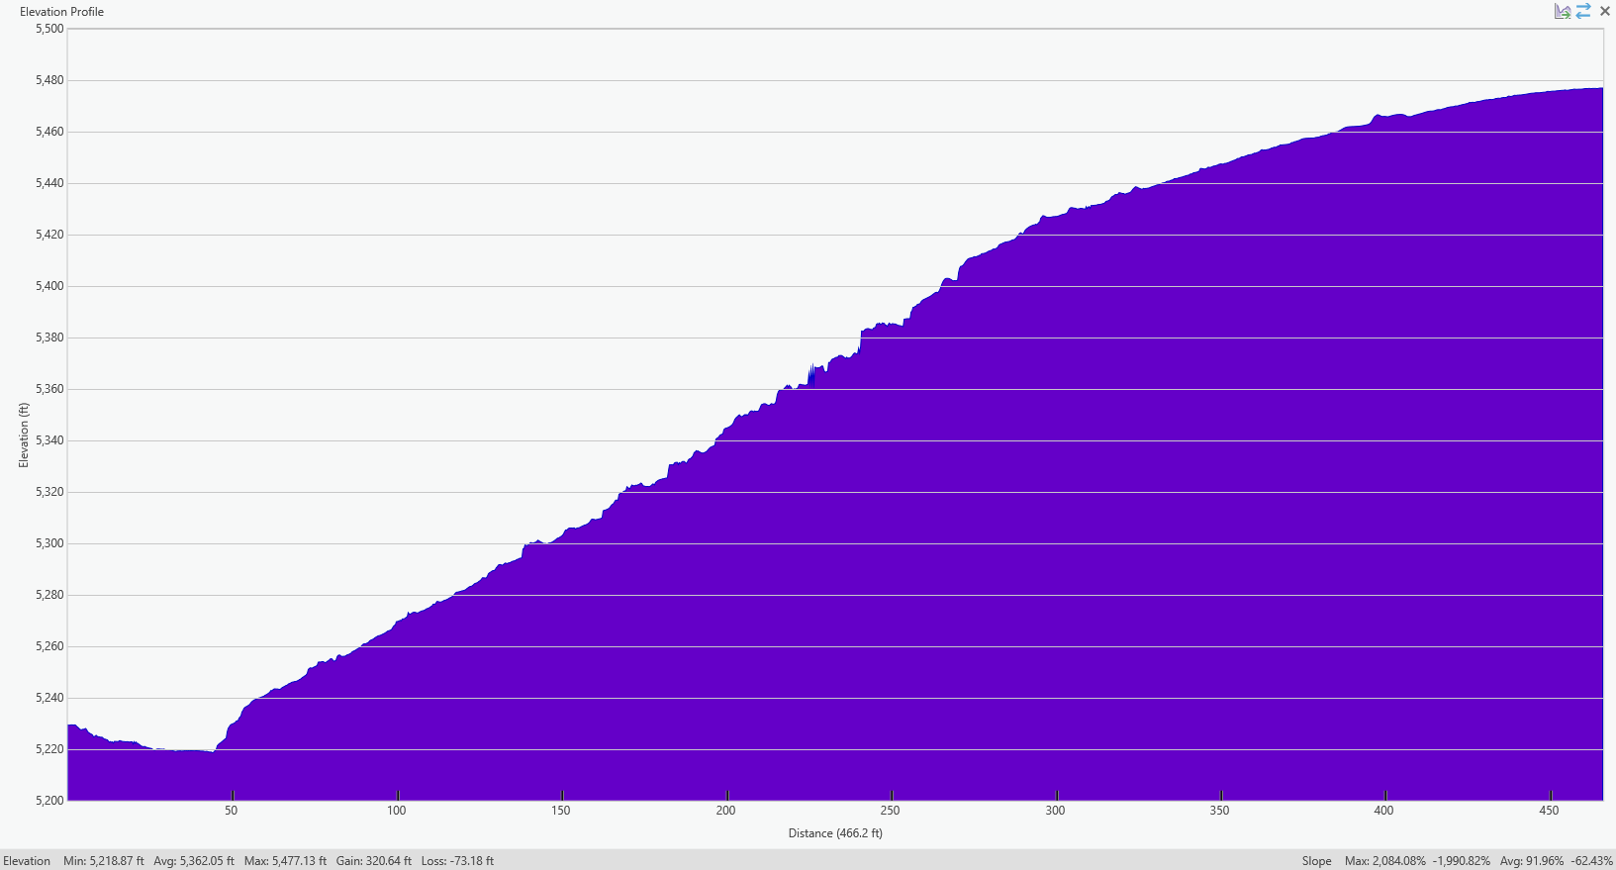

Slide 23
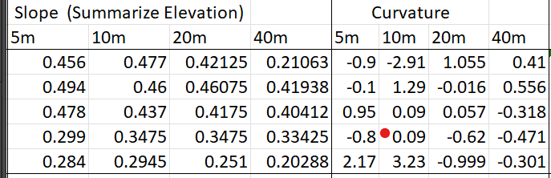
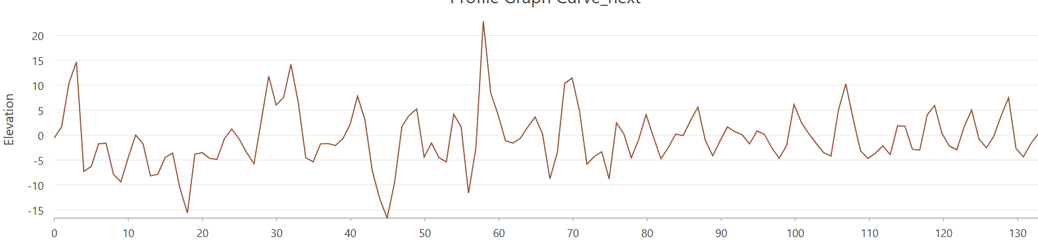

Slide 24
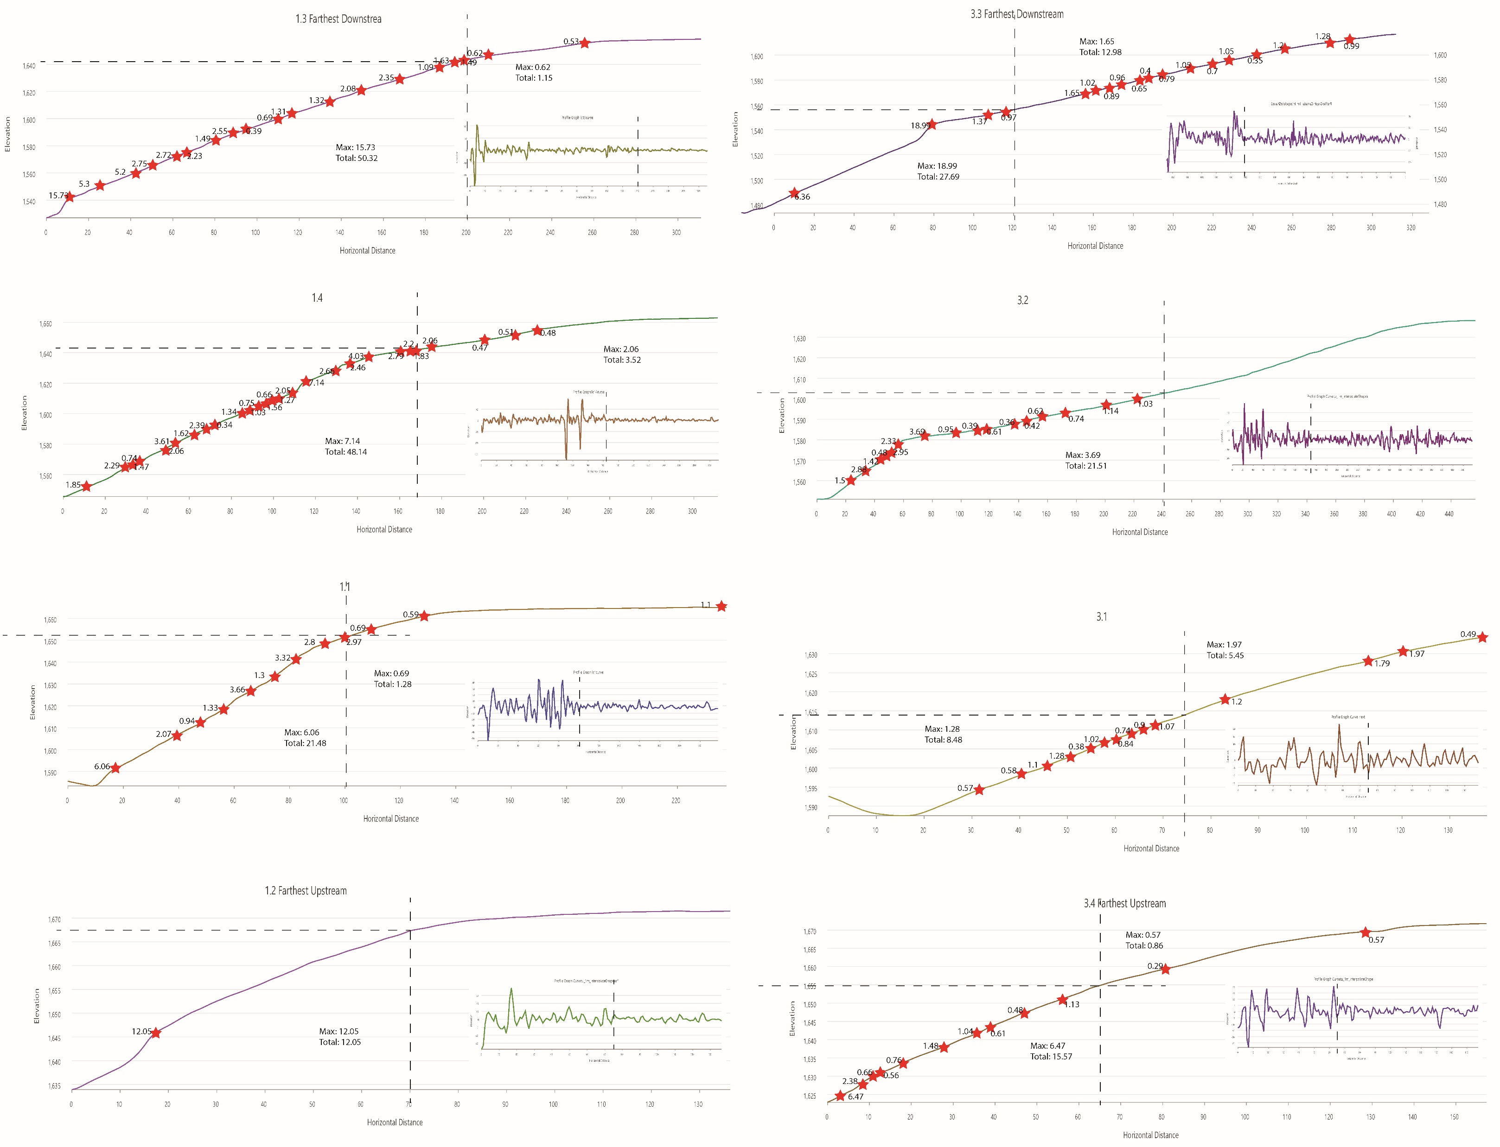

Slide 25
slope

Slide 26
elevation

Slide 27
curvature

Slide 30
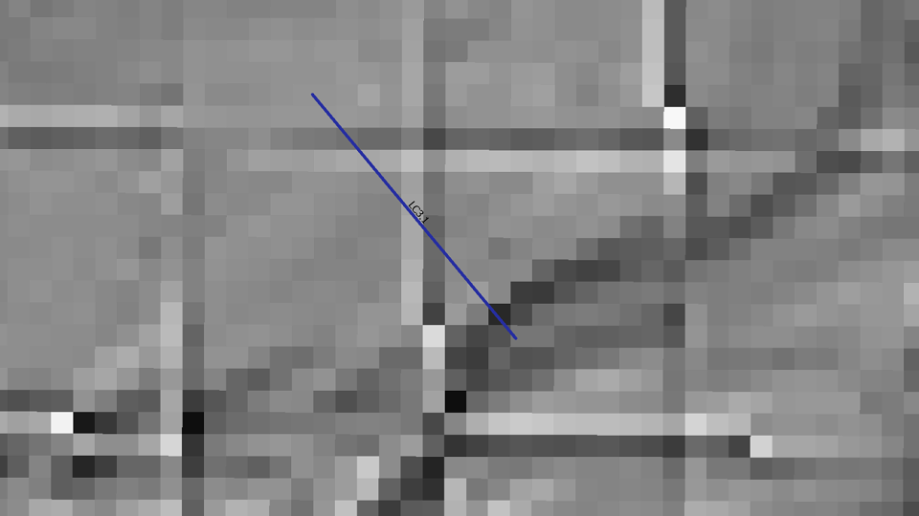

Slide 31
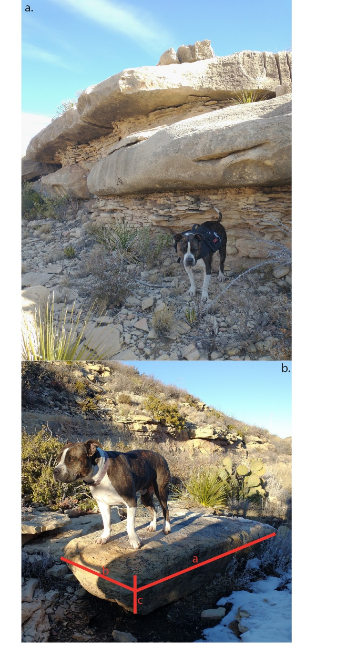
INTRO Figure : Field photos showing a) exposed beds of varying thicknesses and b) a boulder in the channel with dimensions reflective of proximal exposed bedrock.

Slide 32
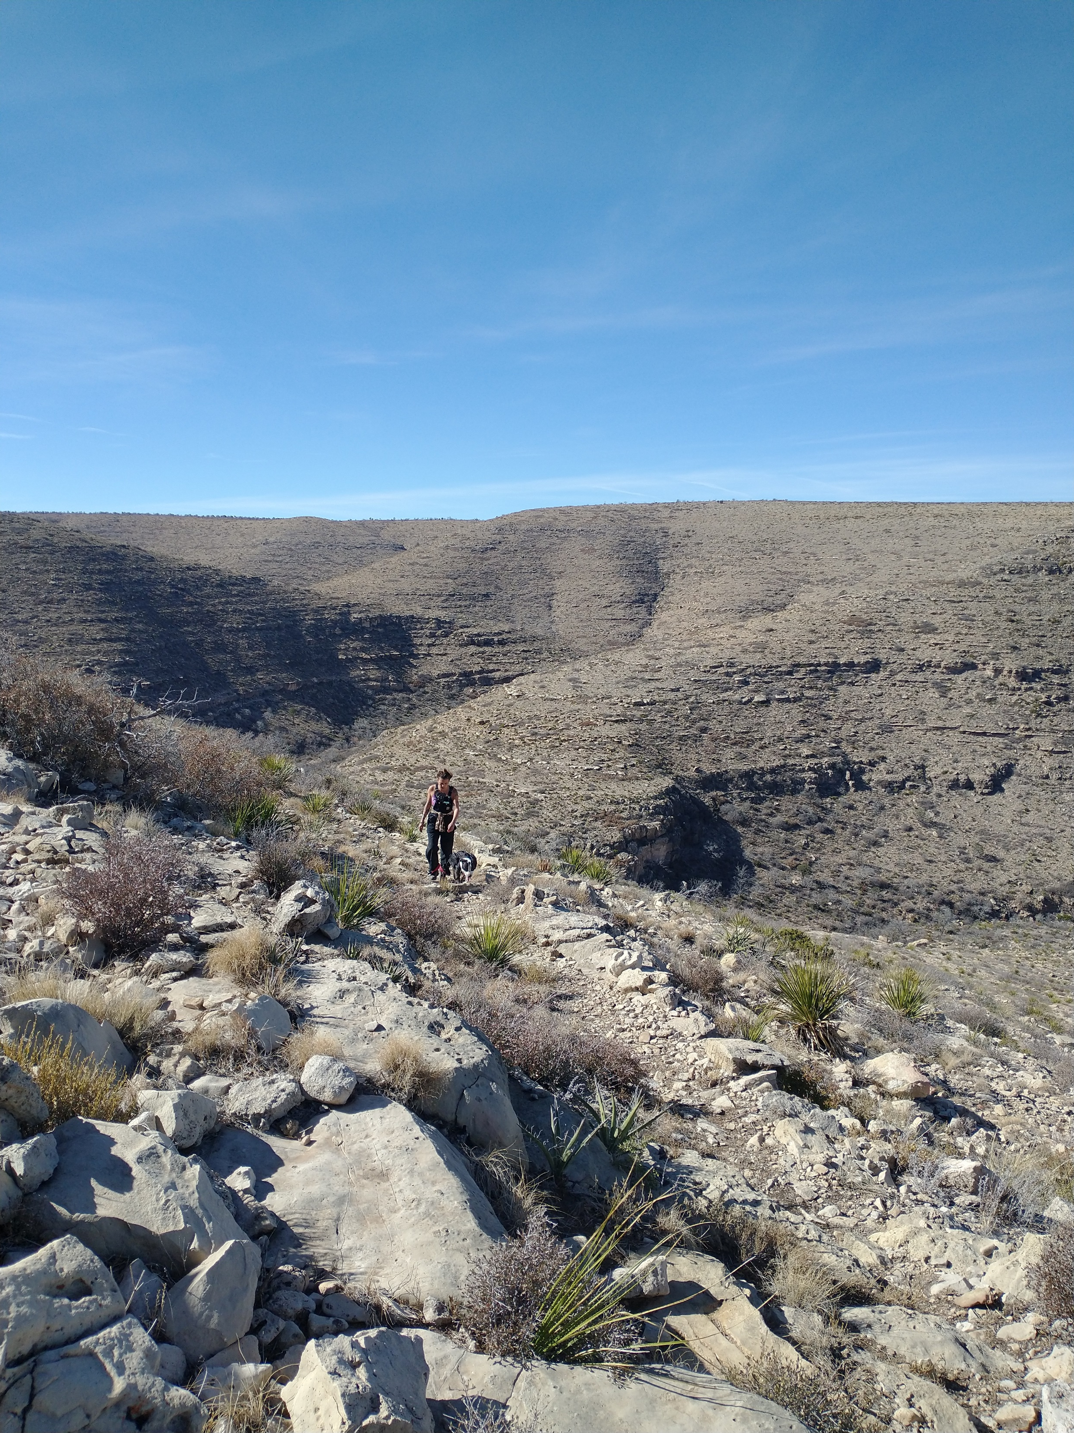
INTRO Figure : Field photo highlighting the steep downstream and shallow upstream hillslopes.

Slide 33
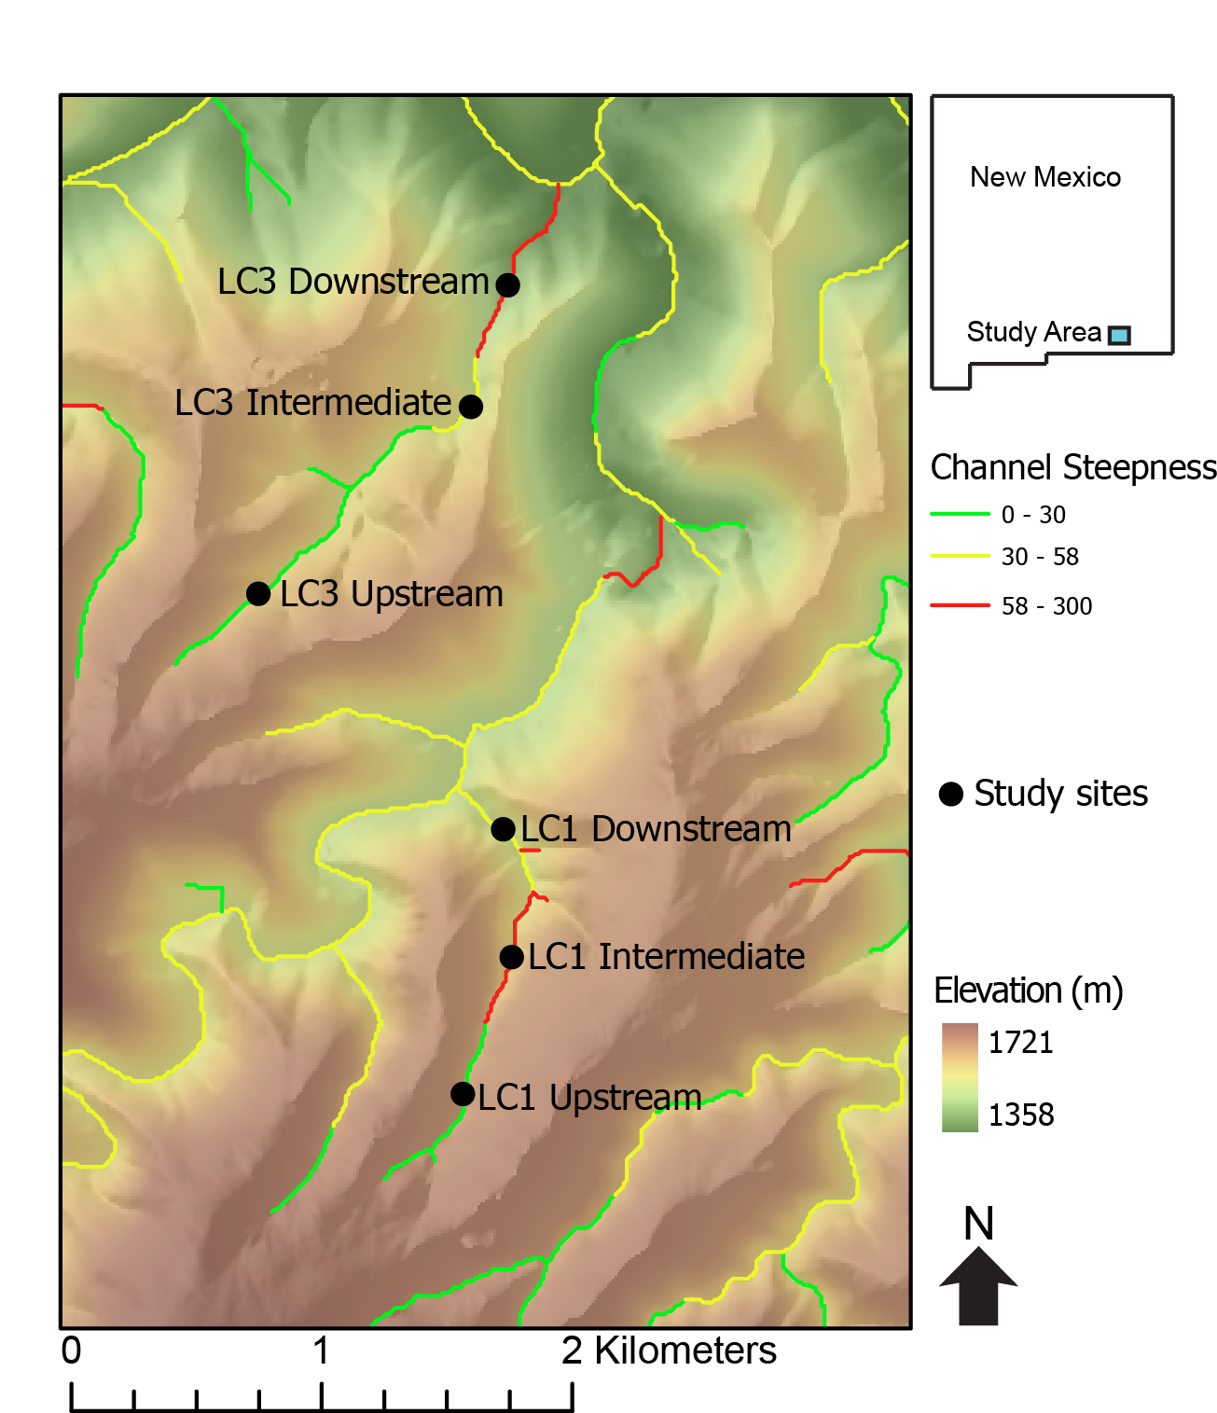
Figure : Topographic map superimposed on a hillshade of Last Chance canyon with ephemeral stream channels. Main stem of channel colored black with arrow indicating the direction of stream flow. The seven hillslope transects in the two different watersheds shown here.
Notes: split into two figures
One with the two watersheds highlighted
No ksn
Second with the transects and Ksns
Maybe break up more detailed map into wtersheds
Other LC3 Upstream

Slide 34
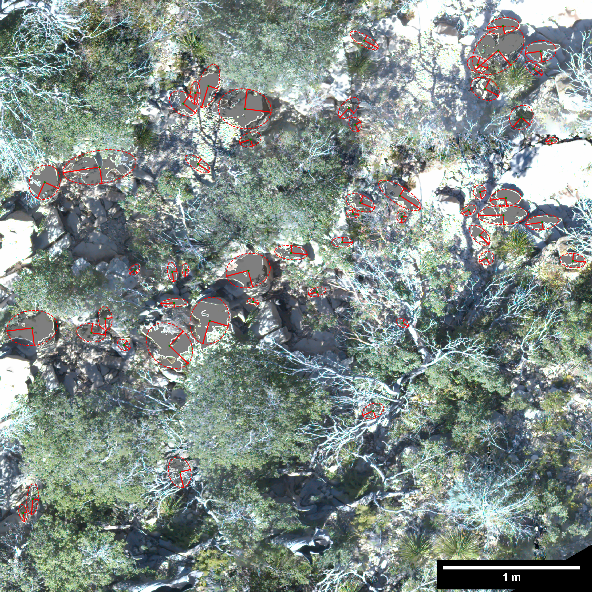
THIS ONE MAY BE DELETED
Figure : Orthomosiac illustrating the photosieving methodology used to measure sediment sizes in stream channels below the seven hillslope transects. Each measured sediment grain has an ellipse with the a (longer) and b axis (shorter) shown.
THIS PHOTO SUCKS. MAKE OWN PHOTO SIEVE FIG

Slide 35
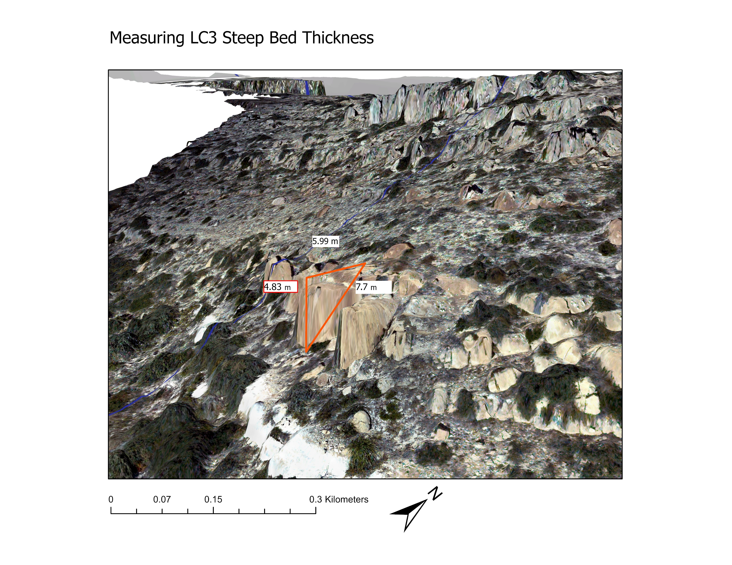
THIS MAY BE DELETED Figure : photo in arcscene illustrating the methodology used to measure beds on hillslopes.
DOUBLE CHECK THE SCALE BAR

Slide 36
Make ksn map, chi plots, show sed size in channels, and bed thicknesses on HS, include this

Slide 38
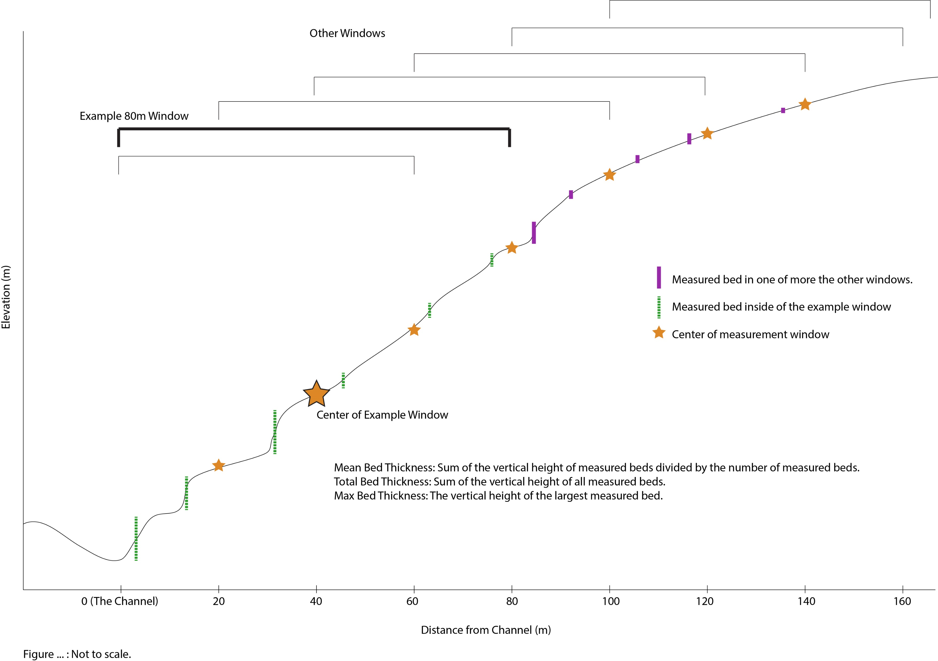
Figure : Schematic (not to scale) demonstrating the 80m window over which both slope and curvature were measured. Note that the 80m window shrinks at the edges of the transect so that data is taken from only the hillslope in question.

Slide 39
Figure : Figure showing the control bed thickness has on slope. Data for both slope and bed thickness are taken over an 80m window. Total thickness is all of the bed heights in he 80m window added together. Mean thickness is the average bed thickness in the window. Max thickness is the vertical distance of the largest bed in the window.

Slide 40
Figure : Bed thicknesses over the entire hillslope transect vs. slope of the entire transect.

Slide 41
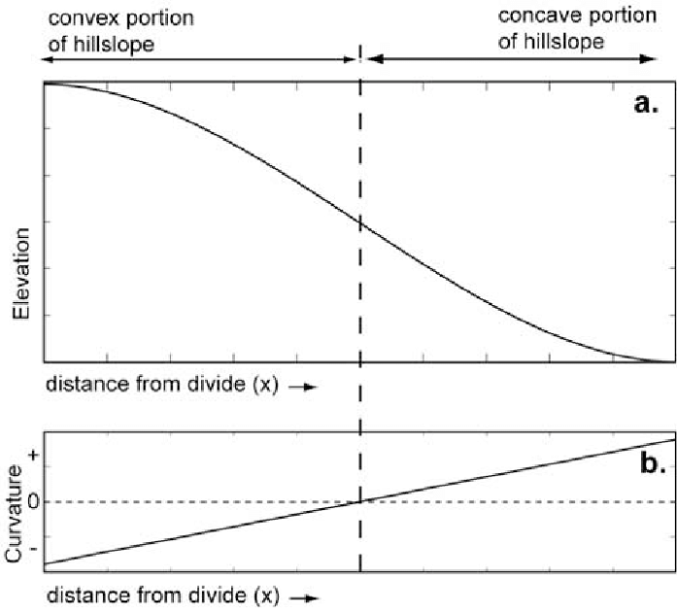
Figure : THIS FIGURE IS UNDER CONSTRUCTION I WANT TO SHOW HOW DIFFUSIVITY CHANGES WITH BED THICKNESS.
a) An idealized hillslope that shows curvature going from positive to negative as distance from channel increases. b) Shallow hillslope transect in LC3 that resembles the diffusive hillslope in a). Max bed thicknesses over each of the seven transects vs c) the slope of the distance vs curvature function and d) the r squared of the distance vs curvature function.

Slide 43
MAYBE PUT STEEPNESS AS A SECOND YAXIS
Figure : Bed thicknesses of the entire transect vs. a) average diameter of the b axis of alluvium in the channel below one of the seven hill slope transects and b) channel steepness (ksn) of the channel below each of the seven hill slope transects.

Slide 44
Figure : Bed thicknesses over the entire hillslope transect vs. channel steepness (ksn) of the channel below each of the seven hill slope transects.

Slide 45
Figure : THIS FIGURE IS UNDER CONSTRUCTION I WANT TO SHOW HOW DIFFUSIVITY CHANGES WITH BED THICKNESS.
LC1 is legit. It’s the most hillslopey and also large sediment appears as if its coming from near the channel.

Slide 49
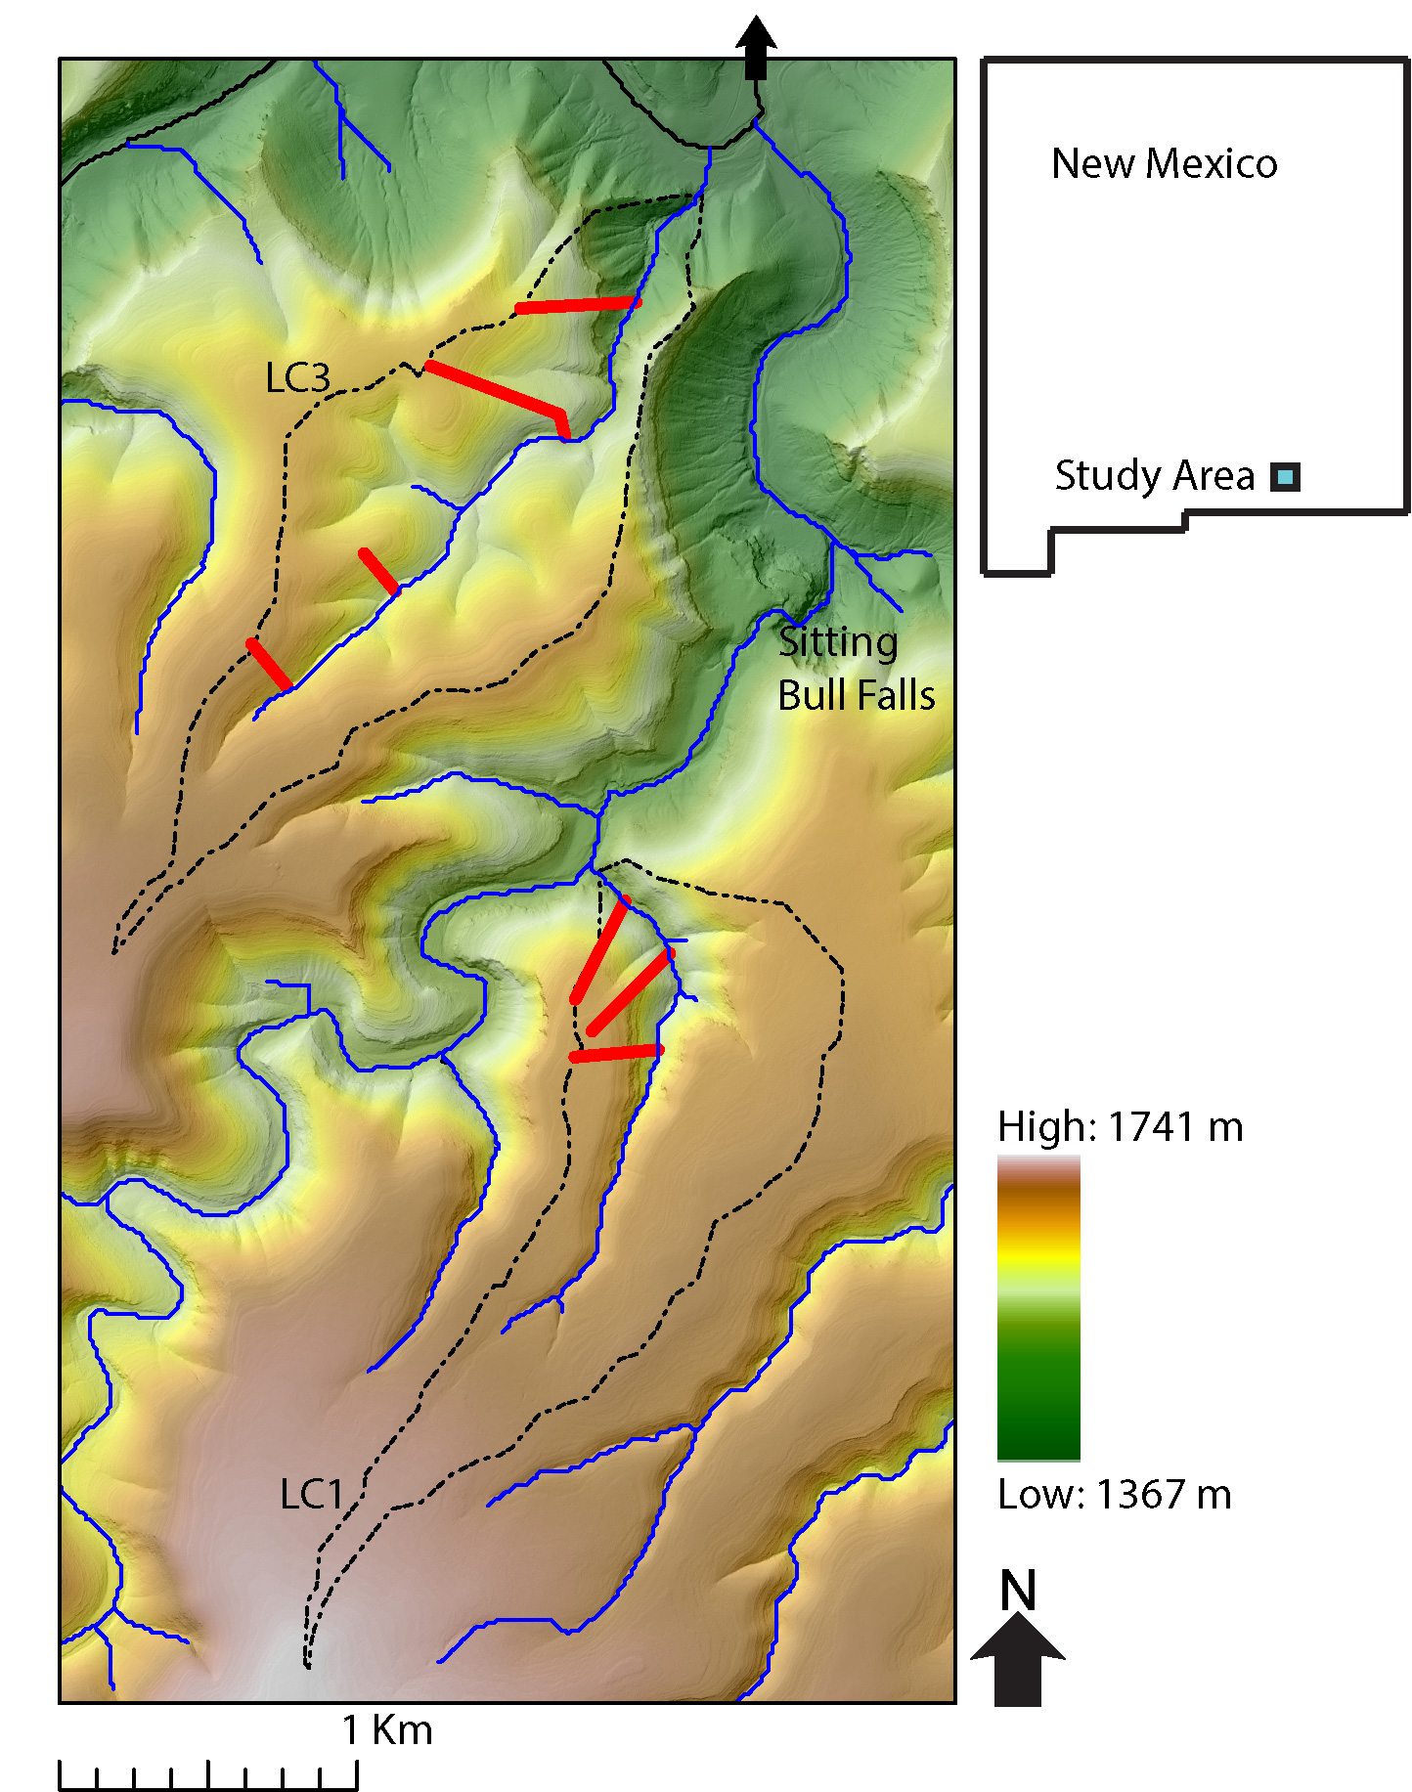

Slide 50
INTRO Figure : Field photo highlighting the steep downstream and shallow upstream hillslopes.

Slide 51
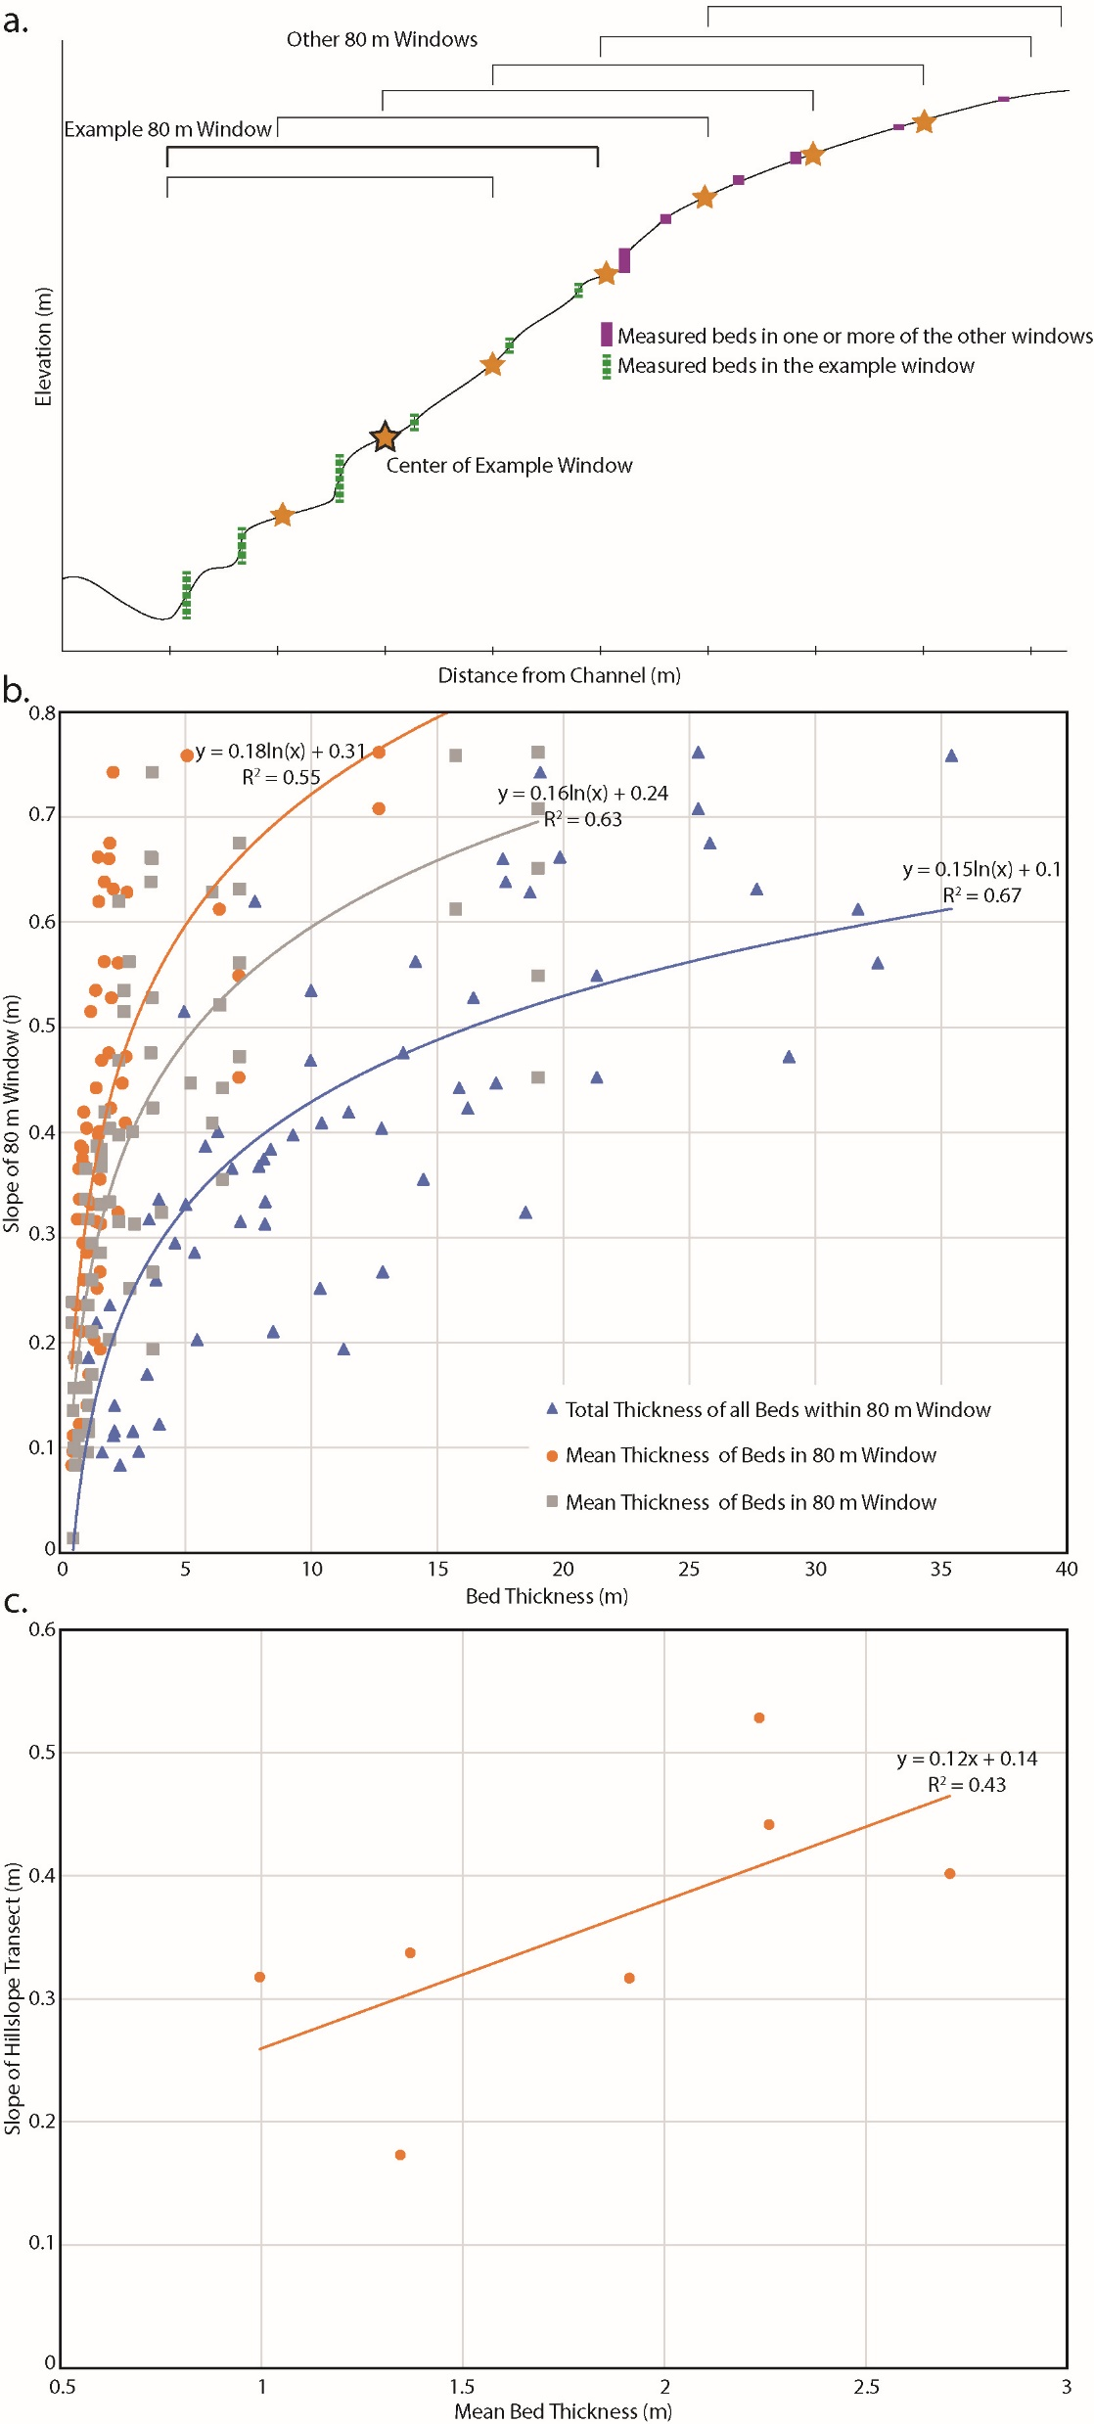

Slide 52
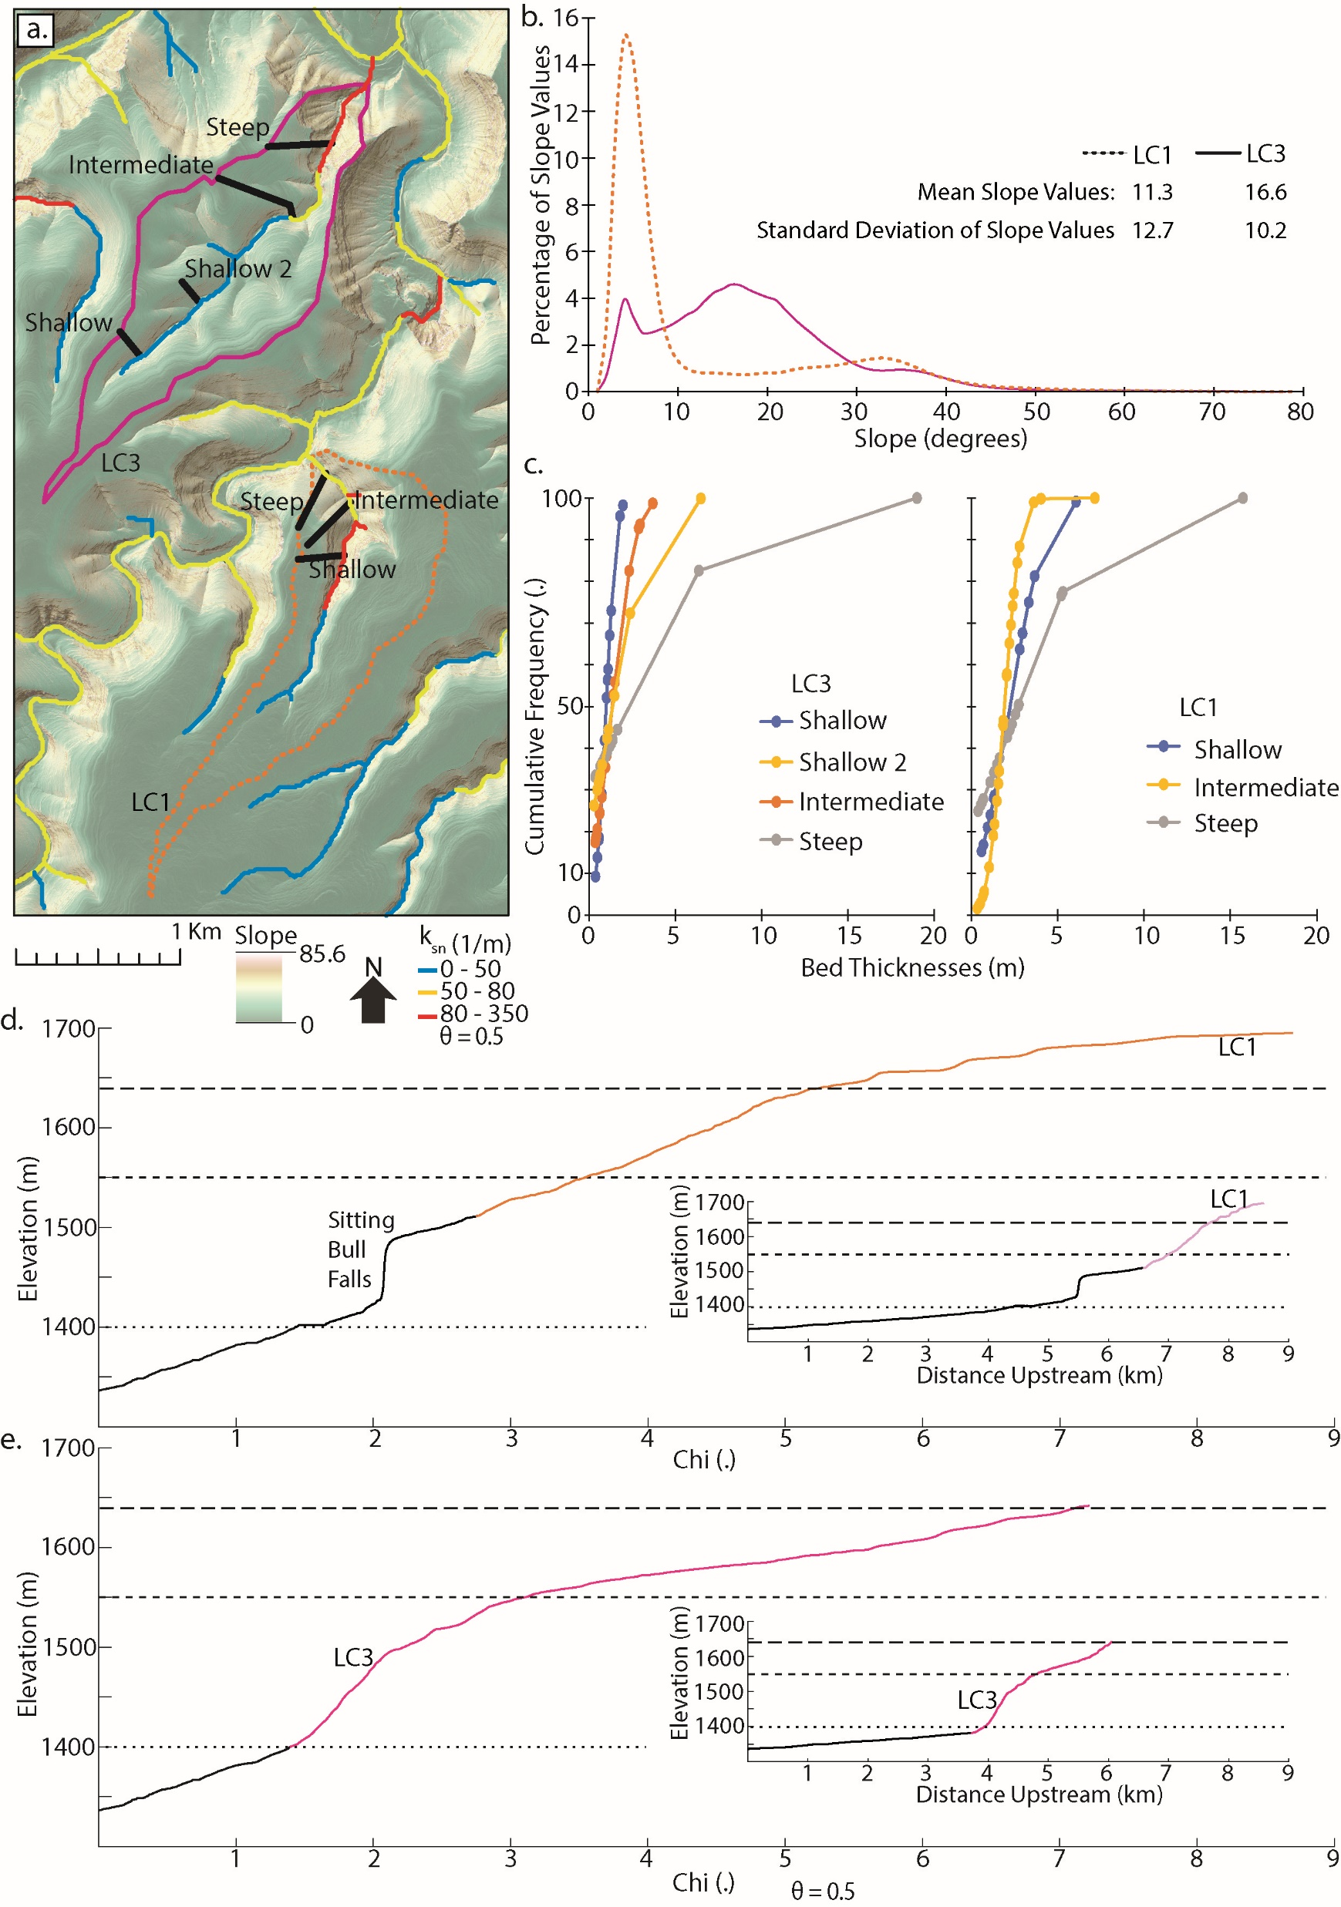
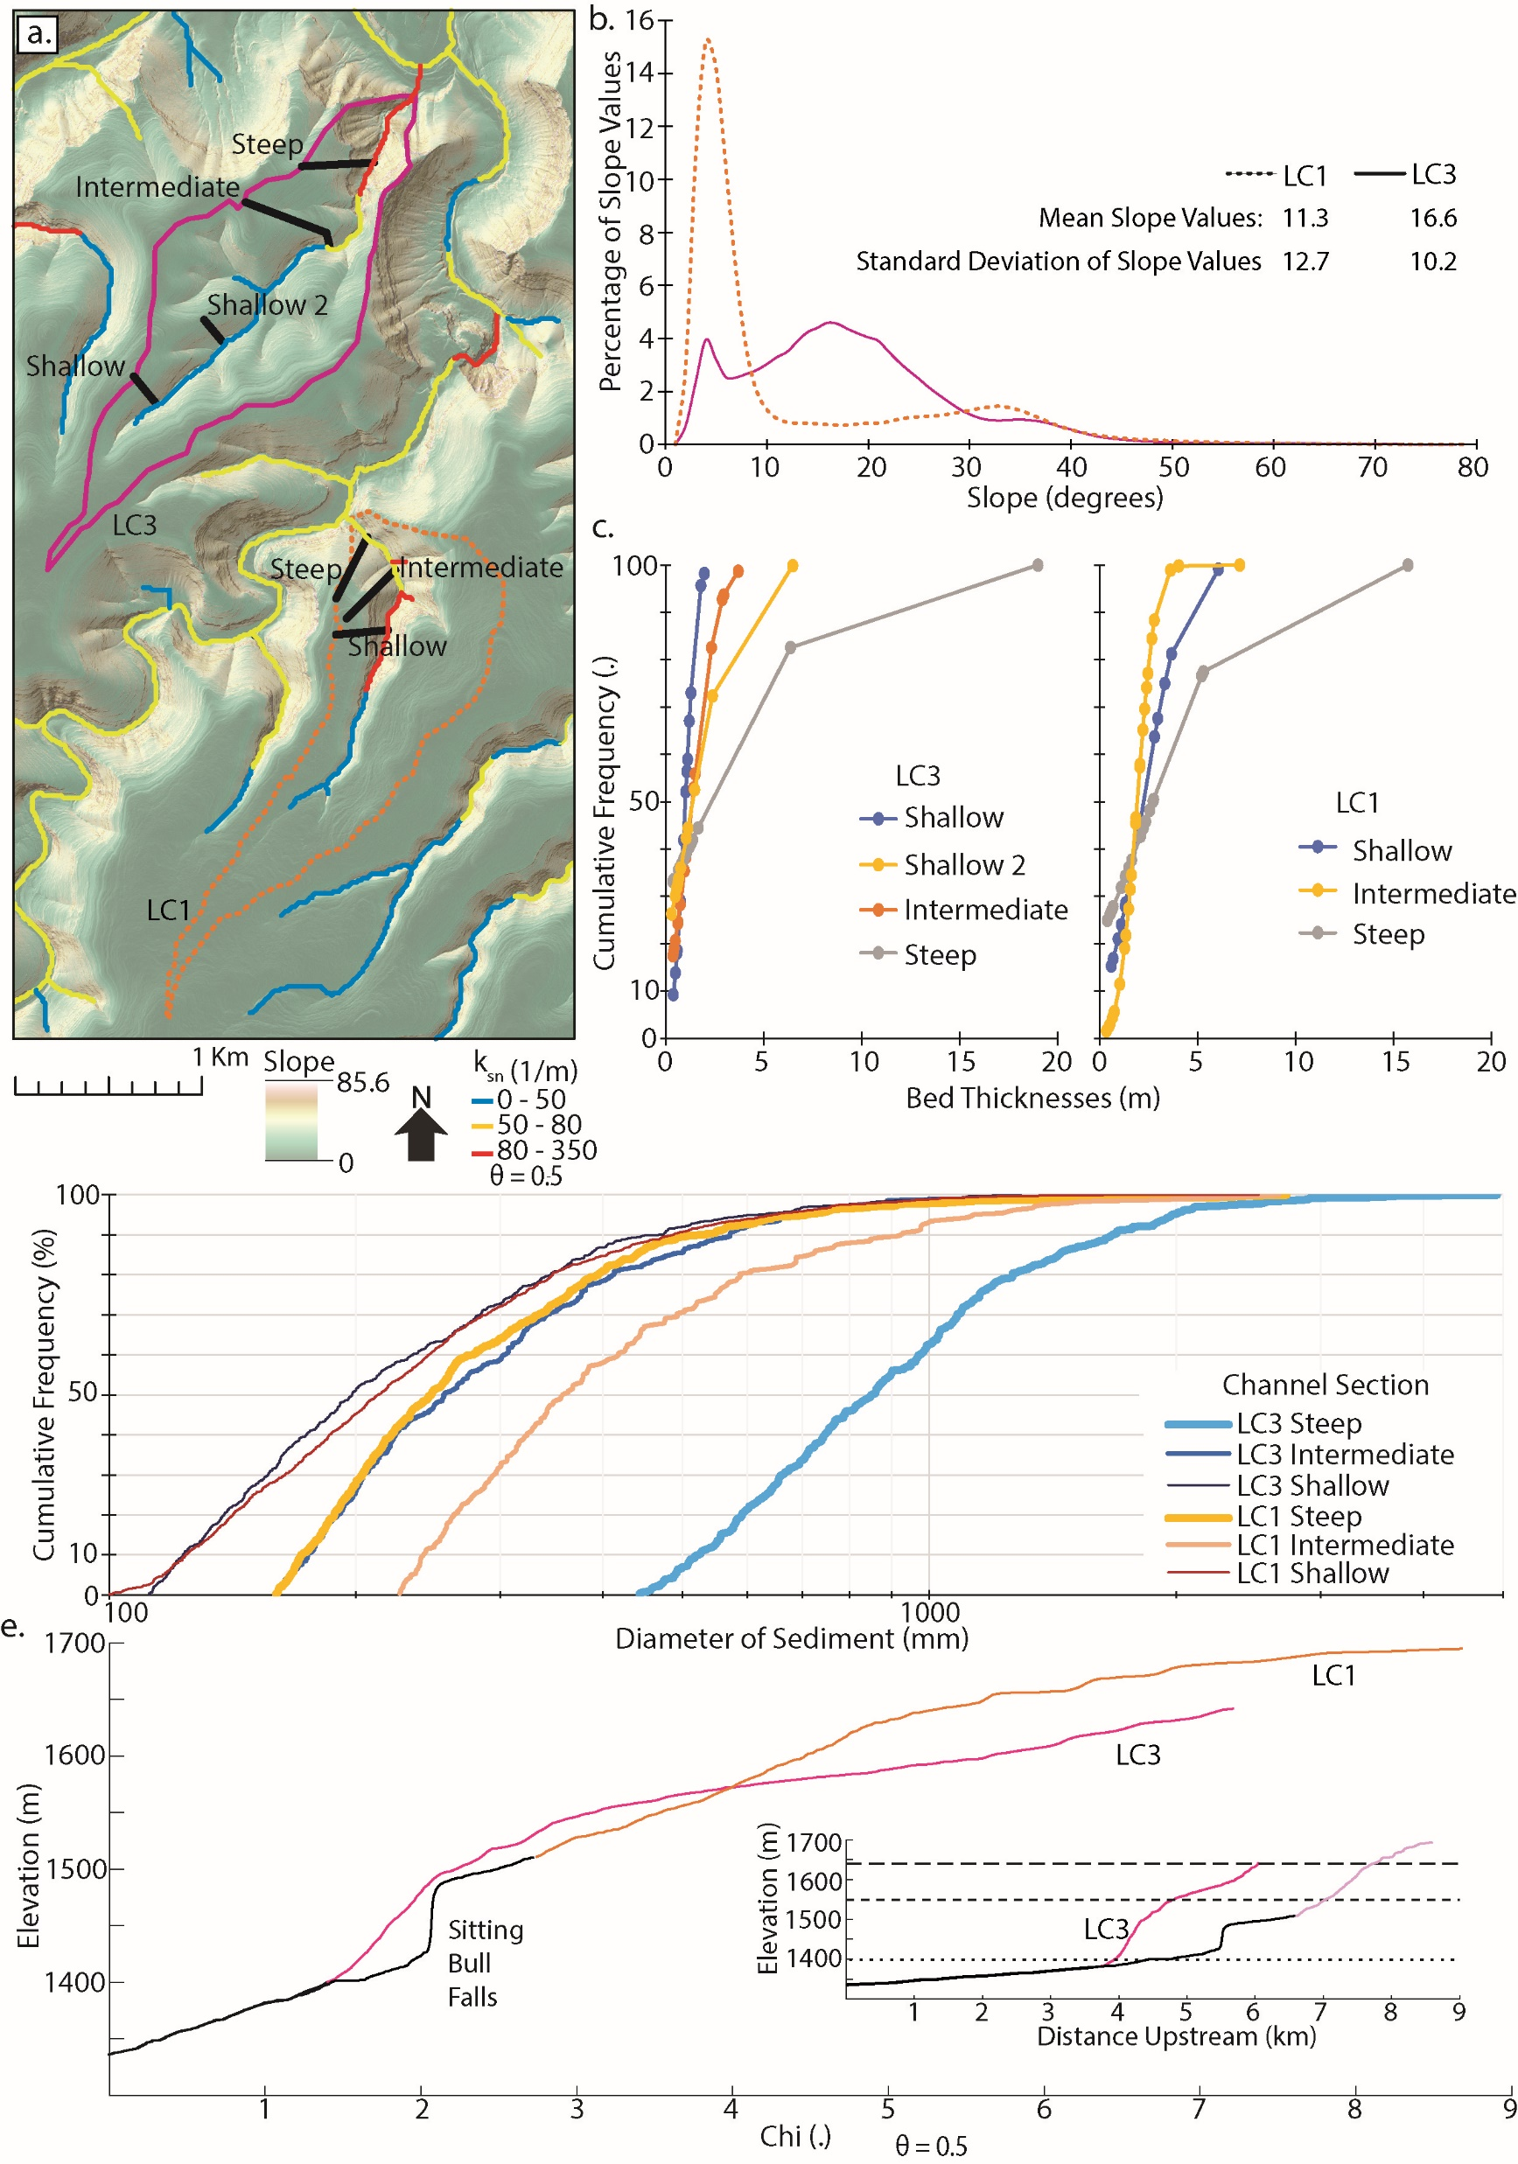

Slide 53
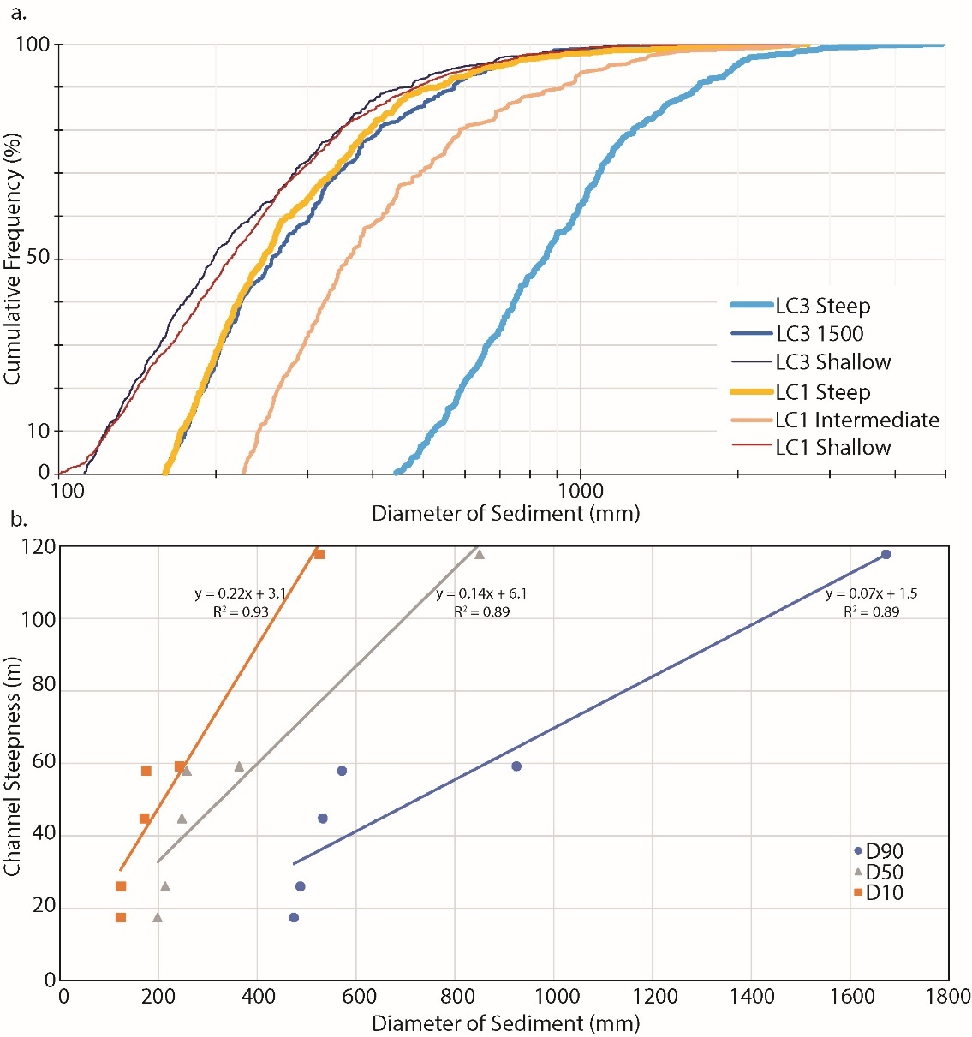

Slide 55
INTRO Figure : Field photos showing a) exposed beds of varying thicknesses and b) a boulder in the channel with dimensions reflective of proximal exposed bedrock.

Slide 57
Figure : THIS FIGURE IS UNDER CONSTRUCTION I WANT TO SHOW HOW DIFFUSIVITY CHANGES WITH BED THICKNESS.
a) An idealized hillslope that shows curvature going from positive to negative as distance from channel increases. b) Shallow hillslope transect in LC3 that resembles the diffusive hillslope in a).

